Slide 1
Business writing layout …and something more

Slide 2

Agenda
Part I
Subject line
Salutation
Body
Closing
Font
Punctuation
Part II
The rule of 10 Cs …and loots of examples

Slide 3
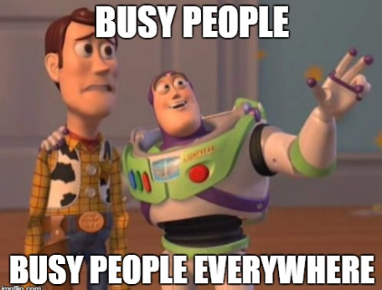
Introduction
What do busy people do:
Read quickly
Scan for key points
Interpret words based on their knowledge
Quickly decide if the message is worth their time
Notes:
Business people are busy, so they read quickly and scan for key points. They also interpret words based on their knowledge. Additionally, they quickly decide if the message is important or deserves their valuable time. For business writers, this means the message should be clear and easy to read. So the reader can quickly get to the point. In other words, to succeed in business you must be able not just to write but to write effectively for business.

Slide 4
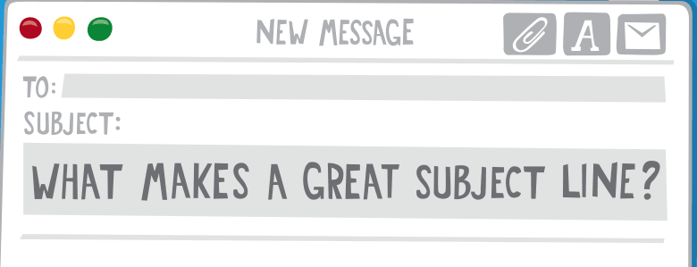


Subject line
Did you know that…
33% of email recipients decide whether or not to open an email based on subject line alone.
FYI: Meeting notes from 3/14 discussion
Program agenda & related information
AGENDA: Staff meeting Thurs 3/12 10:00 pm
Weekly Notes
Here are the URLs
Re: presentation
(blank subject line)
Notes:
No matter what they say, people do judge emails by their subject lines. In fact, 33% of email recipients decide whether or not to open an email based on subject line alone. That's why it's so important to craft subject lines that are compelling enough to get people to click through.
Always fill in the subject line with a topic that means something to your reader. It should be relevant and related.

Slide 5
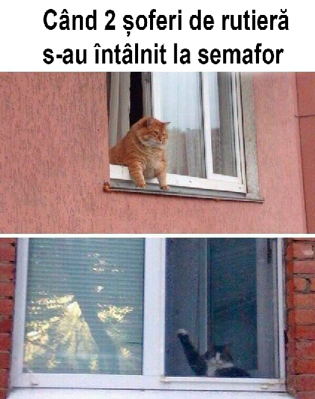
Salutation
Use the name specified in Lync or in the email address
Salutations nearly always begin with "Dear” (formal):
Dear Rosalie,
Dear Dr. Gomez:
In informal letters, we can use:
Hi Jeff,
Hello Professor,
Hello to all,
Greetings, everybody!
Notes:
A salutation is a greeting we use at the beginning of an email, a letter, or a note. Even a text or an online comment can begin with a salutation.
In a letter, salutations nearly always begin with "Dear":
Otherwise, they are more likely to be one of these:

Slide 6
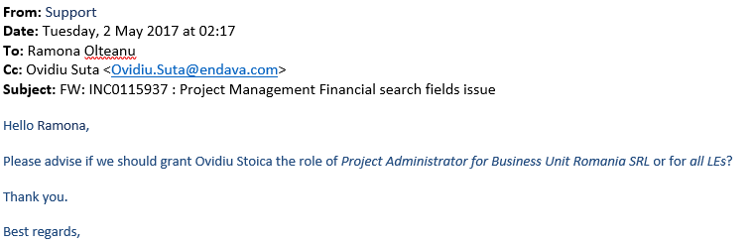
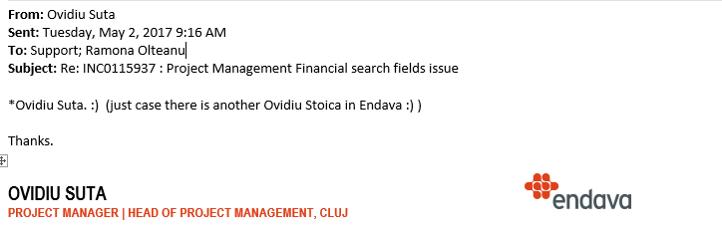
Salutation
Notes:
Never use the wrong name of the person!

Slide 7

Body
The main formats for business letters used are called full block format and indented format/semi-block format.
Notes:
When writing business letters, you must pay special attention to the format and font used.

Slide 8
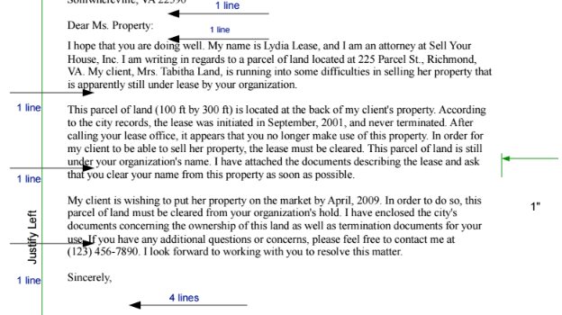
Block Format
The entire letter is left justified and single spaced except for a double space between paragraphs.

Slide 9
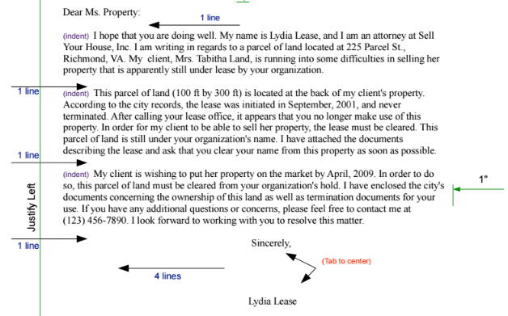
Indented Format
It is much like the modified block style except that each paragraph is indented instead of left justified.

Slide 10
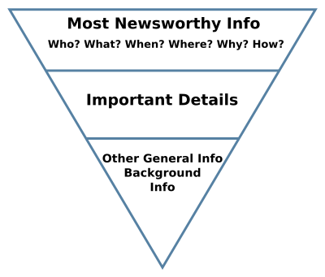
Body Content
The first paragraph of the letter will define the context, providing a clear statement of the letter’s topic and purpose.
Next paragraph will provide the information relevant to its purpose. Each paragraph should cover a single topic or point.
The final paragraph of the letter provide a clear, straightforward statement of the action that will be taken be the writer, requested of the reader, or expected by a third party.
Notes:
When writing a business letter, be careful to remember that conciseness is very important. In the first paragraph, consider a friendly opening and then a statement of the main point. The next paragraph should begin justifying the importance of the main point. In the next few paragraphs, continue justification with background information and supporting details.

Slide 11

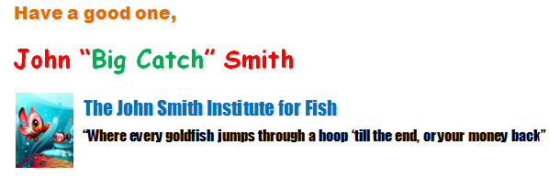
Closing
Formal closing: "Sincerely," "Kind regards," or "Thank you."
Informal: "Best," or "Thanks,“
Insert a company signature under your name and title.
NEVER put Bible verses, quotes, sayings, pictures, etc.
Notes:
Close your letter traditionally for formal communications and with first-time recipients, using a closing such as "Sincerely," "Kind regards," or "Thank you."
If you have established good communication with your recipient, follow-up emails closed with less formal terms such as "Best," or "Thanks," are often appropriate
Type your full name under the closing for a first email and include your title or position under your name. Omit your last name in subsequent emails for a friendlier tone.
Insert a company signature under your name and title. The email signature replaces a letterhead in a print letter. You can also include your email address, website address and cell phone number.

Slide 12
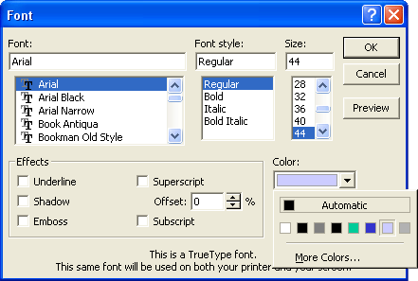
Font
The generally accepted font is Times New Roman, size 12, although other fonts such as Arial may be used.
It may be appropriate to use a serif variation but avoid colored signatures/body font, or “cutesy” fonts, such as:
Comic Sans
Chiller
Brush Script
Blackadder ITC
Notes:
The generally accepted font is Times New Roman, size 12, although other fonts such as Arial may be used. When choosing a font, always consider your audience.
If you can choose your own fonts, please use standard black, Times New Roman, 12 point font. This is considered standard by the Modern Language Association (MLA). It may be appropriate to use a serif variation but avoid colored signatures/body font, or “cutesy” fonts, such as:

Slide 13
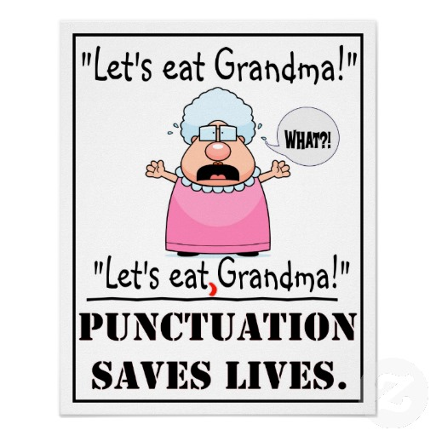
Punctuation
What do you mean,
“End of story”?
You never know when to stop, do you?
Notes:
When we speak, we have tone and facial expressions. When we write, we have words on the page, and the punctuation marks. The exclamation point is used, of course, to indicate a surprise element, and the question mark means a question's being asked. Those are easy. But what about the pesky comma? The comma is the most used, and the most abused punctuation mark. I'm convinced that sometimes the only reason a comma is inserted is that "It looked like a good place," or "I breathed," or "I haven't used one for awhile." However, that comma can completely change the meaning of your message.

Slide 14
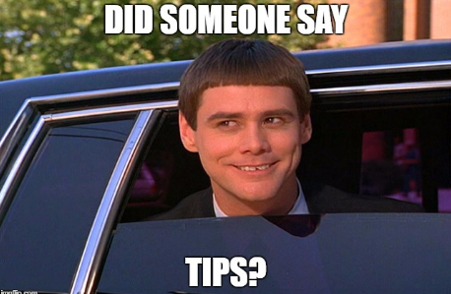
Tip time!
AVOID WRITING IN ALL CAPS. IT COMES ACROSS AS DOMINEERING AND FORCEFUL. NO ONE LIKES TO BE YELLED AT!
avoid writing in all lowercase. it comes across as confusing and reflects poorly on the sender of the email.
PLZ do not abbreviate words or phrases b/c not everyone knows what you are saying.
Avoid using emoticons; they're too cute for serious business email ☺
Write in short paragraphs.
Stick to one topic

Slide 15
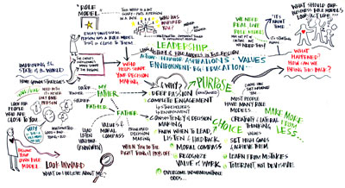
Layout
The look of a page is important.
Show the reader your organization and help him be organized.
There are three layout techniques:
Use short paragraphs
Use headings
Use bullets and other lists

Slide 16

10 Cs rule
Considerate
Coherent
Conversational
Concise
Complete
Concrete
Clear
Credible
Courteous
Correct
Notes:
If you want to help improve the chances that your message will be read, or understood the way you intended, and make a good impression on your reader, understanding and applying the C's to your writing as you plan and revise, can help you accomplish those goals. A reader has a right to expect every message to be…
Even though these are listed in distinctive categories, they're not mutually exclusive, they do overlap. For example, a message may be unclear because it is incomplete. Or a writer may be inconsiderate of the reader by sending a message that is filled with incorrect punctuation. Or the reader's name is spelled incorrectly. But looking at them in categories helps us more easily discuss what makes an effective message for our audience. Let's take a brief look at each C

Slide 17
Complete
Did you provide your reader the information that he/she needs, so that follow-up questions aren’t necessary?
You will need to contact the team leader who has just been assigned to the recruiting team. The leader will tell you when and where the next meeting is and the agenda. Let the team leader know that you have been notified of this change.
You will need to contact Jim Bain, the new team leader for the recruiting team. Jim will notify everyone when and where the next meeting is and provide the agenda. Let Jim know at company@ourcompany.org by 5:00 p.m. Friday that you have been notified of this change.
Notes:
Who is the new team leader? How should he be contacted? When is the information needed?

Slide 18

Concise
Did you use the fewest words possible so your busy reader doesn’t need to see useless information?
We are writing to inform you that the purpose of this letter is to indicate that if we are unable to mutually benefit from our seller/buyer relationship, with satisfactory payment, then we have no alternative other than to sever the relationship. In other words, unless the account is handled in 45 days, we will have to change your terms to a permanent COD basis. Due to the fact that your account is past due for the amount of $1,500, the privilege of buying on credit will in the future no longer be available because we can longer provide that service until your unpaid balance is paid.
107
words
Please pay your $1,500 account balance by (date) to keep your credit account open. After that date, your account will be permanent COD.
23
words
Notes:
The example contains a lot of words that don’t add any meaning. “We are writing to inform you”? Well, of course.

Slide 19


Clear
Have you thought about what your reader knows and doesn’t know and the words you choose to use or you’re writing based on what YOU know and what makes sense to you?
Jack told Jim that he could leave the meeting early.
Jack said to Jim, “You may leave the meeting early.”
Jack told Jim that Jim could leave the meeting early.
Jack said to Jim, “I am leaving the meeting early.”
Notes:
The problem is that we don’t know who gets to leave the meeting early—Jack or Jim?

Slide 20

Conversational
Does your writing sound like you’re writing to a human or to a robot?
Please be advised that I am sending your materials pursuant to your request under separate cover and also inquiring today in regards to your August 10 Order #249. Thank you for the acknowledgement that you received it. Kindly let me know if the order was complete upon receipt of it. With reference to the aforementioned order, it was shipped August 4.
You will receive your requested materials in a separate package. Also, was Order #249 (shipped August 4) complete?
Notes:
“Please be advised,” “pursuant to your request,” and “in regards to” are not conversational phrases.

Slide 21

Courteous
Is your tone pleasant and did you show your reader how he/she benefits from your information OR does the message sound demanding?
You can’t use that door even if it is closer to the parking lot because company policy says that door is to be used only by guests. I can’t grant you an exception. You certainly should know by
now which door is the employee door!
Door A is reserved for guests only. Door B is always available for all employees.
Notes:
This example contains negative words (“can’t” and “company policy”) and uses a preachy tone.

Slide 22

Courteous
If you had followed the instructions that came with the product, you wouldn’t be requesting another one to replace the broken one you returned. Even though you didn’t follow the directions, we are going to send you a replacement.
You will receive your replacement, along with an updated instruction manual, by Friday. Page 13 diagrams the steps to using your product to ensure that it provides years of dependable service.
Notes:
This example uses a preachy tone and lingers on the negative, but it also places blame on the customer.

Slide 23

Correct
At the first glance, does your message look professional and give a good first impression?
Here are a list off the attendees; Susanna Arreaza, Doris Belmount, Pam Burin, Steve Corey and Lou Waters. The list is is complete. If you want too request more information about the class. Please call 937.99.92.
Here is a list of the attendees: Susanna Arreaza, Doris Belmount, Pam Burin, Steve Corey and Lou Waters. The list is complete. If you want to request more information about the class, please call 937.99.92.
Notes:
This example has problems with subject-verb agreement, look-alike words, punctuation, proofreading, homonyms, and sentence structure.

Slide 24
Coherent
Do you leave the reader the idea that the words are jumbled or that they’re tied together smoothly?
A new process for correcting pay check errors will begin Monday. Reminder: Have you signed up for the company bowling league yet? The landscaping on the north side will begin next month.
Reminders:
1. A new process for correcting paycheck errors will begin Monday.
2. The company bowling league signup ends Wednesday.
3. The landscaping on the north side will begin next month.
Notes:
This example contains three different ideas with nothing to connect.

Slide 25
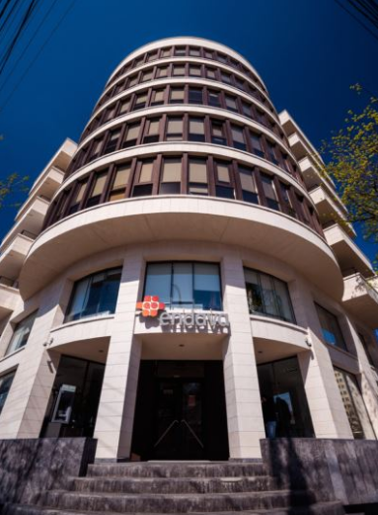
Considerate
When a reader looks at your document, does it look inviting to read, with bullets and headings OR does it use 1-2 long paragraphs?
VP Ryan’s Agenda Items for Next Month’s Meeting:
• Tower Building Update: The Tower Building, which is being considered for a new storage location, is 12,000 sq. ft., 2,000 sq. ft. more than our minimum requirement. The building inspector
will report on his findings about the building’s condition.
• Overtime Pay: It will be reduced.
• Parking Lot: New security lights that will be installed by the end of the quarter.
The building was inspected last month by our VP, and it exceeded the minimum requirement we need for a new storage facility. Ryan said to make certain that everyone on the committee knows that our minimum requirement is 10,000 sq. ft. and that the Tower Building is 12,000 sq. ft. Other items on the agenda for the next meeting are overtime pay, which needs to be reduced, and parking lot upgrades. Ryan mentioned that the building inspector will give a report on the Tower Building’s condition. The parking lot will get new security lights by the end of the quarter.
Notes:
This example contains three different ideas with nothing to connect.

Slide 26
Concrete
Have you included specifics or there are meaningless words used?
As we discussed, I needed to work to the best of my abilities, and I think I improved.
I called on more customers and made more sales. I was on time almost always for my appointments and remembered to bring extra forms.
Based on the performance improvements you recommended, I achieved the following:
• Called on 14 customers this month (8 last month)
• Sales increased to $7,234 from $5,670
• Met clients at scheduled time except for Mr. Axsom. (10 minutes late because of traffic backup and
I let him know I would be late)
• Had a complete supply of all forms customers requested.
Notes:
This example contains vague words that don’t project confidence, such as “I think” and “almost.”

Slide 27
Credible
Are reliable facts given from sources that can be located?
Most of our clients think that we should add more company services. One of the services mentioned is a delivery service. I know someone I can contact who provides that service and have already contacted him.
Based on a client survey, 70% of our customers would use a delivery service. Lynn Smelter, owner of Smelter’s Delivery Service, which has been in business for over 20 years, has agreed to give us detailed information by the end of the month.
Notes:
Ask the right questions—which or how many clients? What services? Whom do you know (a brother-in-law who is out of work?), and why did you contact them without
authorization?

Slide 28
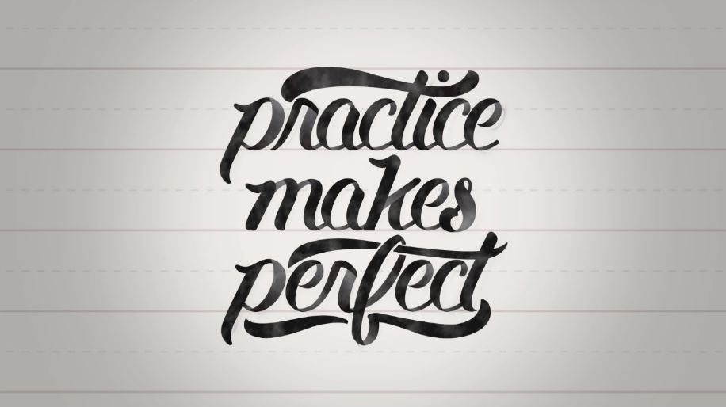
Practice!
Notes:
Practice makes perfect. Whether you want to improve your golf, yoga, cooking or writing skills, you need to practice. Each time we practice the techniques or principles, we are reinforcing the correct process or procedures. The more we practice correctly, the better we become. With enough practice and effort, we eventually become proficient and may even excel

Slide 29
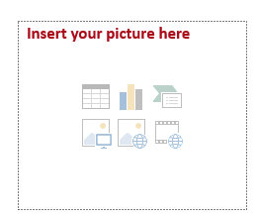
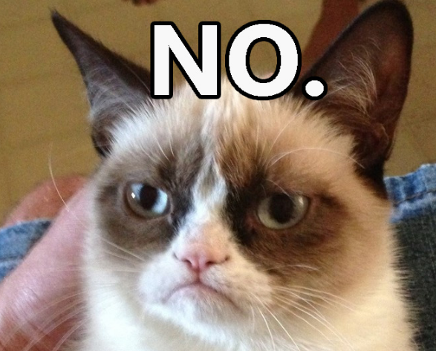
Thank you
Cristina Purice
AM Engineer

